Slide 1



Customer Segmentation
Presented By :
Shagufta Nadaf 243547
Shruti Patil 243549
Institute for Advanced Computing and Software Development, Akurdi

Slide 2


Introduction to Customer Segmentation
Customer segmentation is the process of dividing customers into distinct groups based on shared characteristics, preferences, and behaviors.
This allows businesses to better understand their customer base and tailor products, services, and marketing strategies to meet the unique needs of each segment.
The overall aim of this process is to identify high-value customer base i.e. customers that have the highest growth potential or are the most profitable.

Slide 3


Overview of PySpark
1
Scalable and Distributed
2
Machine Learning Capabilities
PySpark is a Python API for Apache Spark, a powerful big data processing engine that can handle large-scale data efficiently.
PySpark provides a suite of machine learning algorithms that can be used for customer segmentation and other data-driven business insights.
3
Integrates with Python Ecosystem
PySpark seamlessly integrates with the broader Python data science ecosystem, allowing for a comprehensive analytics workflow.

Slide 4
Data Preparation and Exploration
Data Ingestion
Data Cleaning
Exploratory Analysis
Load customer data from various sources into a PySpark DataFrame, handling different data formats and structures.
Identify and address missing values, inconsistencies, and outliers in the data to ensure data quality.
Analyze the data to understand the key characteristics, patterns, and relationships within the customer base.

Slide 5

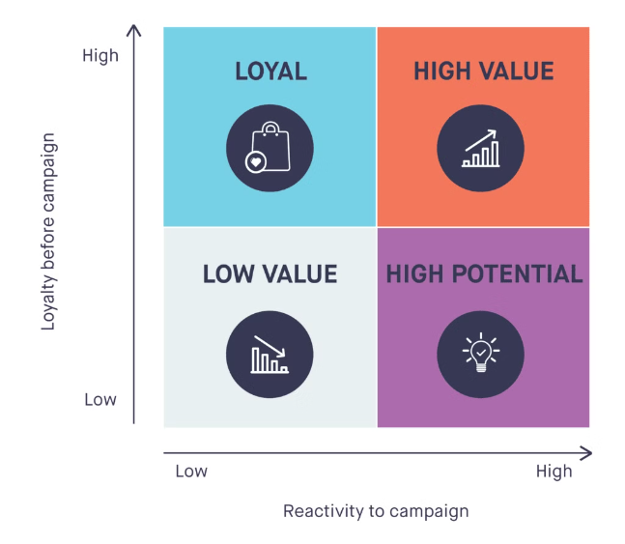
Quartile-based Segmentation
1
Identify Metrics
Determine the key metrics that will be used to segment customers, such as purchase frequency, average order value, and customer lifetime value.
2
Calculate Quartiles
Divide the customer base into four equal-sized groups based on the selected metrics, creating high, medium-high, medium-low, and low quartiles.
3
Analyze Segments
Examine the characteristics and behavior of each customer segment to understand their unique needs and preferences.

Slide 6

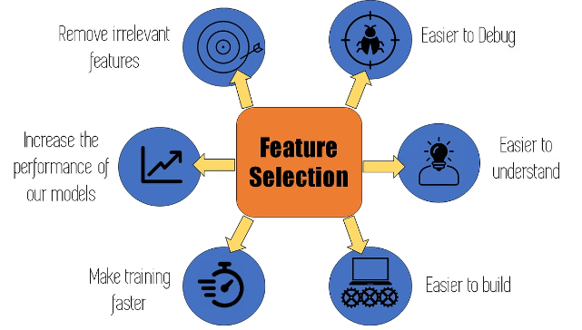
Feature Engineering and Selection
Feature Engineering
Feature Selection
Create new customer features by combining or transforming existing data to better capture their unique characteristics.
Identify the most important features that contribute significantly to the customer segmentation model, improving its accuracy and performance.
Dimensionality Reduction
Apply techniques like principal component analysis to reduce the number of features while maintaining the most relevant information.

Slide 7
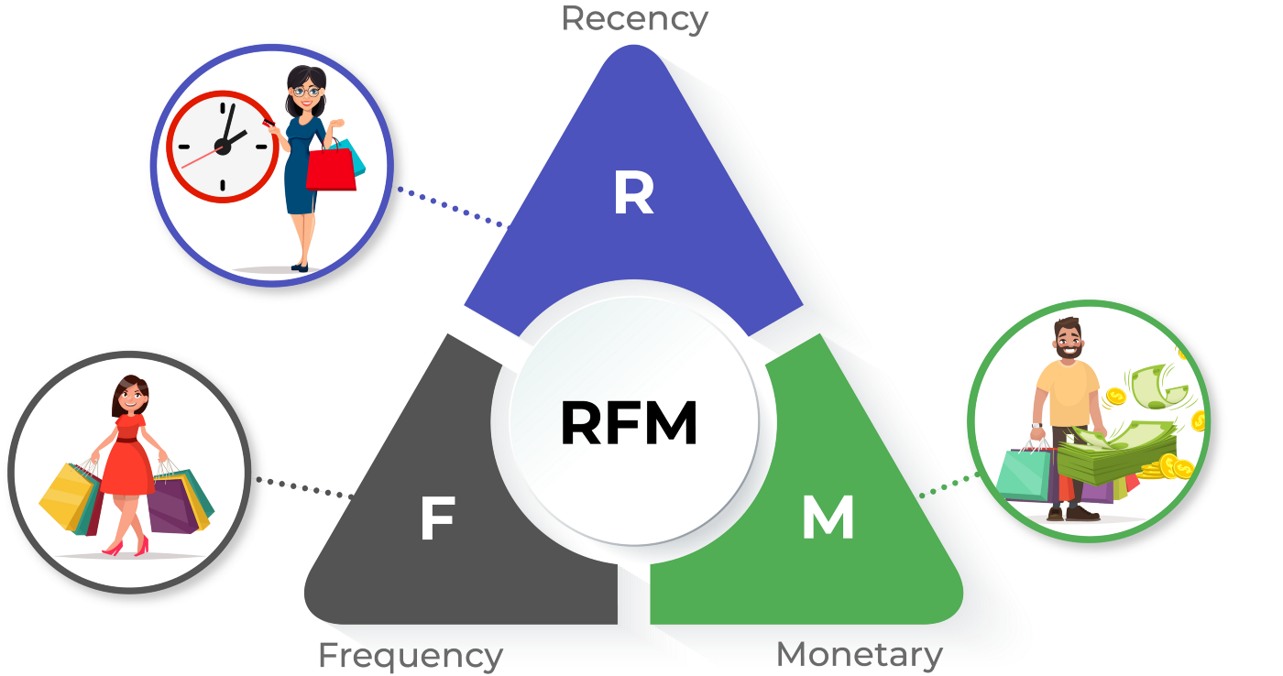
RFM
1
RFM stands for Recency, Frequency, Monetary
RFM analysis is a proven marketing model for behaviour-based customer segmentation. It groups customer based on their transaction history – how recently, how often and how much did they buy.
2
RFM helps divide customers into various categories or clusters to identify customers who are more likely to respond to promotions and also for future personalization services.
3

Slide 8
RFM
1
2
3
RECENCY
FREQUENCY
MONETARY
The amount of time since the customer’s most recent transaction (days, months, weeks, hours)
Formula :
R = Current Date−Last Purchase Date
E.g. 10 days
The total number of transactions made by the customer (during a defined time)
Formula:
F = Number of Purchases
E.g. 10 transactions
The total amount that the customer has spent across all transactions (during a defined period)
Formula:
M = Total Spend
E.g. $600

Slide 9
Quartile :
Represents a division of a dataset into four parts based on the distribution of values.
In RFM, quartiles are calculated for recency, frequency, monetary values to understand the distribution of customer behavior.
Quartiles are used to rank customers within each RFM metric.
Each quartile is assigned a number from 1 to 4, with 4 being best and 1 being worst.
Example: If a customer is in the top 25% for recency(most recent purchase), they would be in the 4th quartile for recency.

Slide 10

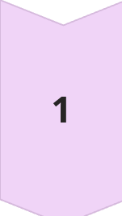
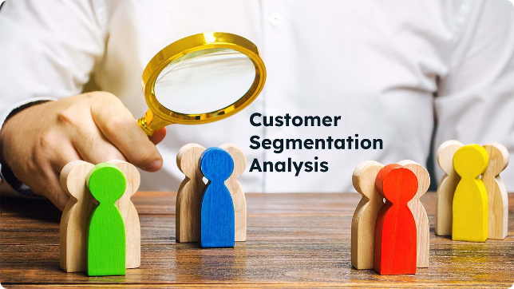
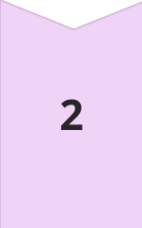
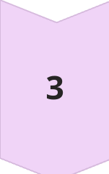
Conclusion and Next Steps
Actionable Insights
Use the customer segmentation insights to develop personalized marketing strategies, product offerings, and customer experiences.
Continuous Improvement
Regularly review and refine the customer segmentation model to adapt to changing customer preferences and market dynamics.
Expansion Opportunities
Identify potential growth opportunities by understanding the unique characteristics and needs of each customer segment.

Slide 11
Future Aspects :
Integration of AI and Machine Learning
Ethical and Privacy Considerations
Incorporating Additional Data Sources
Behavioral and Sentiment Analysis
Integration with Emerging Technologies
Customer Journey Mapping and Lifecycle Segmentation

Slide 12
Thank You

